Slide 1
Week Three

Slide 2
Outline
Other important concepts
Reception
Almuten
Peregrine
Essential and Accidental Dignity
Putting the Dignities together

Slide 3
Other Important Concepts
Reception
Almuten
Peregrine

Slide 4
Reception

Slide 5
Reception
Reception is about the relationship between a planet and the ruler of the sign it occupies
The ruler is said to receive the planet
Reception requires that the ruler can see the sign it rules.
Aversion breaks reception in the strict traditional sense.

Slide 6
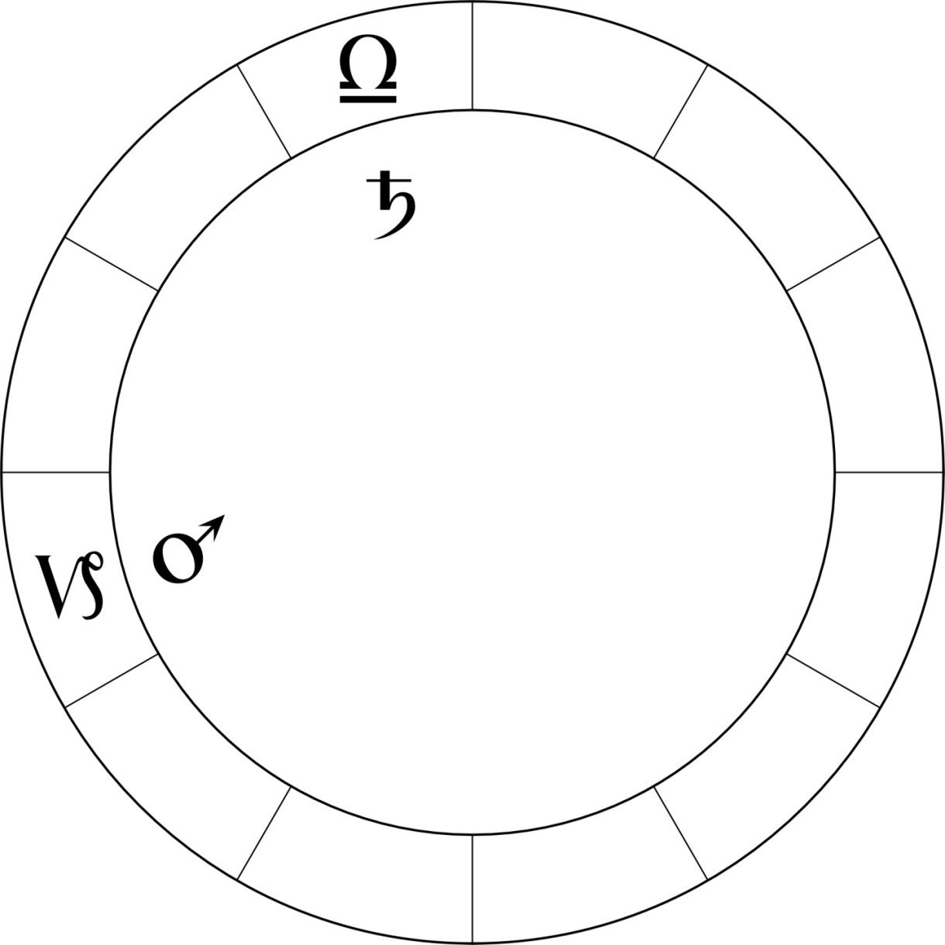
Reception with an Aspect
Saturn is in square to Mars.
Saturn is exalted, and Mars is in a sign Saturn rules - Saturn receives Mars in his house.
Saturn must treat Mars well.
Note Saturn is in the detriment of Mars, so Mars' effect on Saturn will be difficult.
Notes:
Saturn receives Mars in his rulership. Hence Saturn here is "well-disposed" to Mars and obligated to treat Mars well.

Slide 7
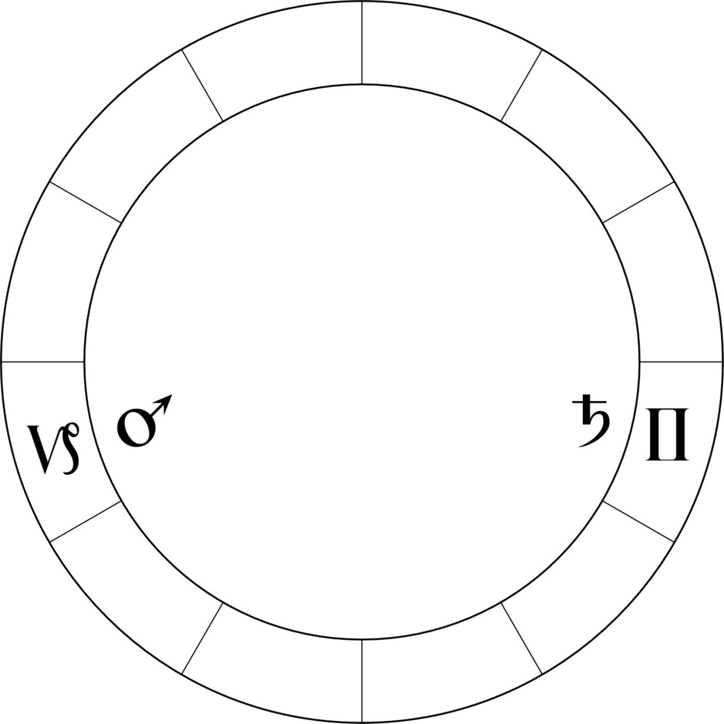
Reception with Aversion
Saturn receives Mars in his house, but there is no whole sign aspect between them - Saturn is averse the house it rules here.
This is not complete reception in the earliest traditional astrology.
Because of the aversion, Saturn is hindered in ruling the first house here because it is out of communication, out of awareness - an absentee landlord.
Notes:
Saturn rules Mars in Capricorn but can't see it. So in traditional astrology there is no reception here.

Slide 8
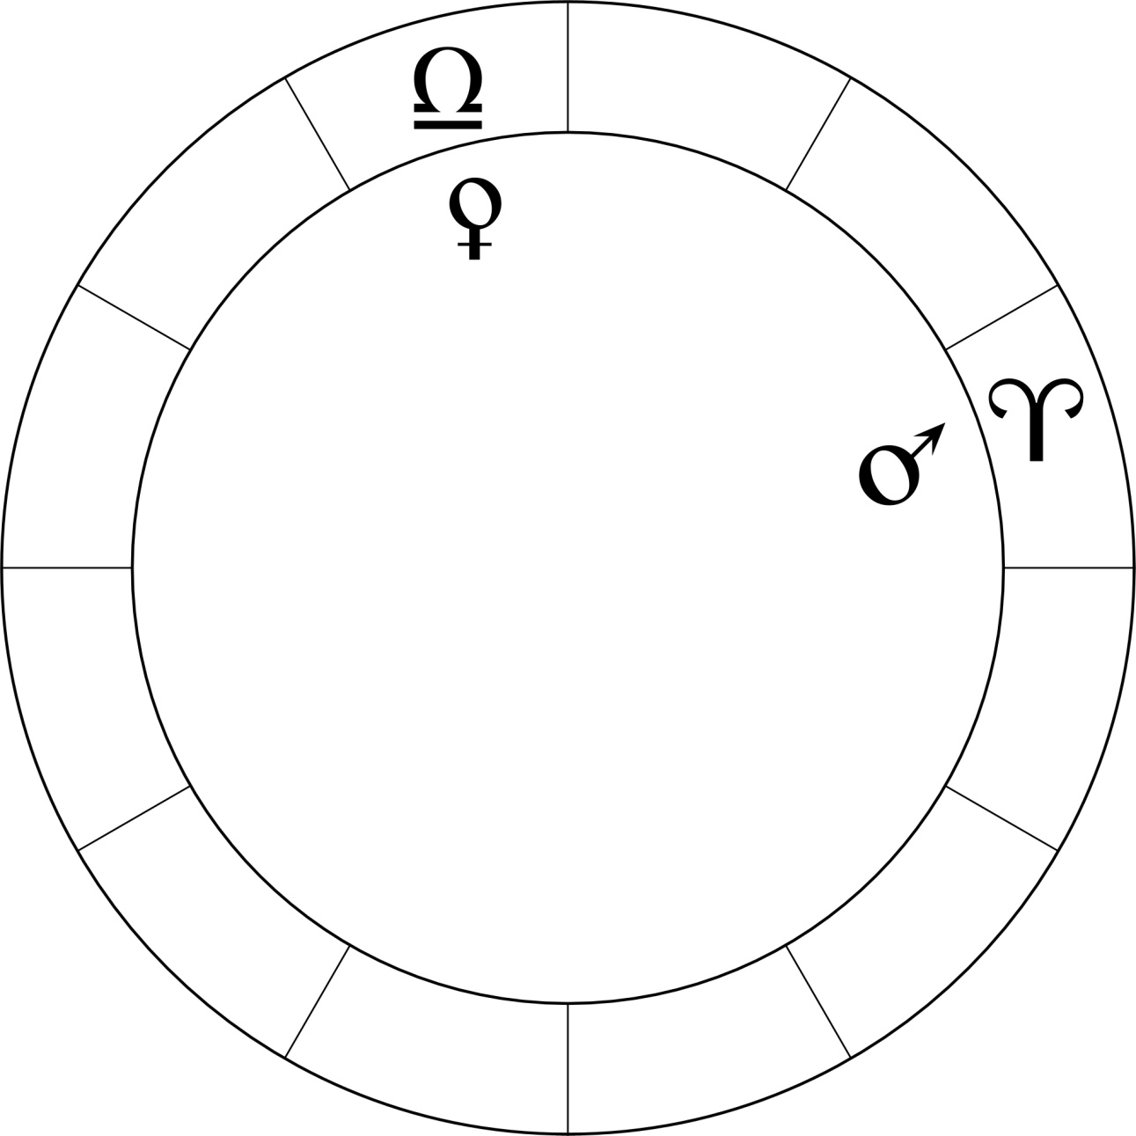
Aspect without Reception
Mars and Venus are square each other.
Venus is in the detriment of Mars.
Mars is in the detriment of Venus.
Since there is no reception between them, this will be a difficult aspect relationship.

Slide 9
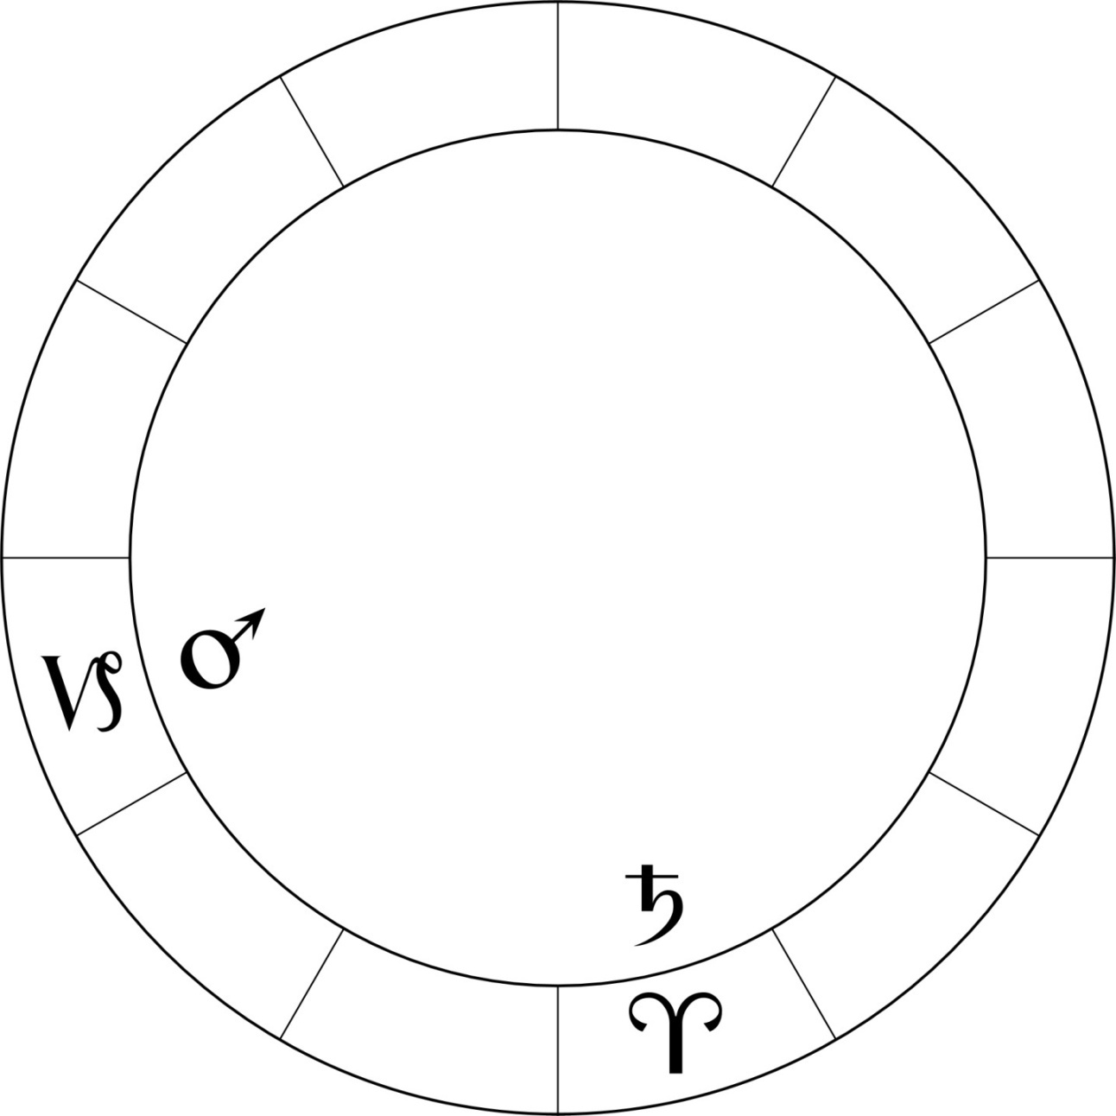
Mutual Reception
Saturn receives Mars in a house he rules.
Mars receives Saturn in a house he rules.
They are each obligated to treat the other well.
In William Lilly's words, mutual reception abates all malice.
Notes:
Each receives the other planet into his rulership, and there is a clear whole sign aspect between them. Even though there is a square aspect, the reception "abates all malice".

Slide 10
Mutual Reception Important
I have found that when there is major reception between two planets in a chart, that those planets play a critical role in tying the whole chart together.
While mutual reception is preferable with an aspect, I have found that mutual reception with averse planets can be important.
Mutual reception with aversion can indicate the relationship is outside the person's awareness or control.

Slide 11
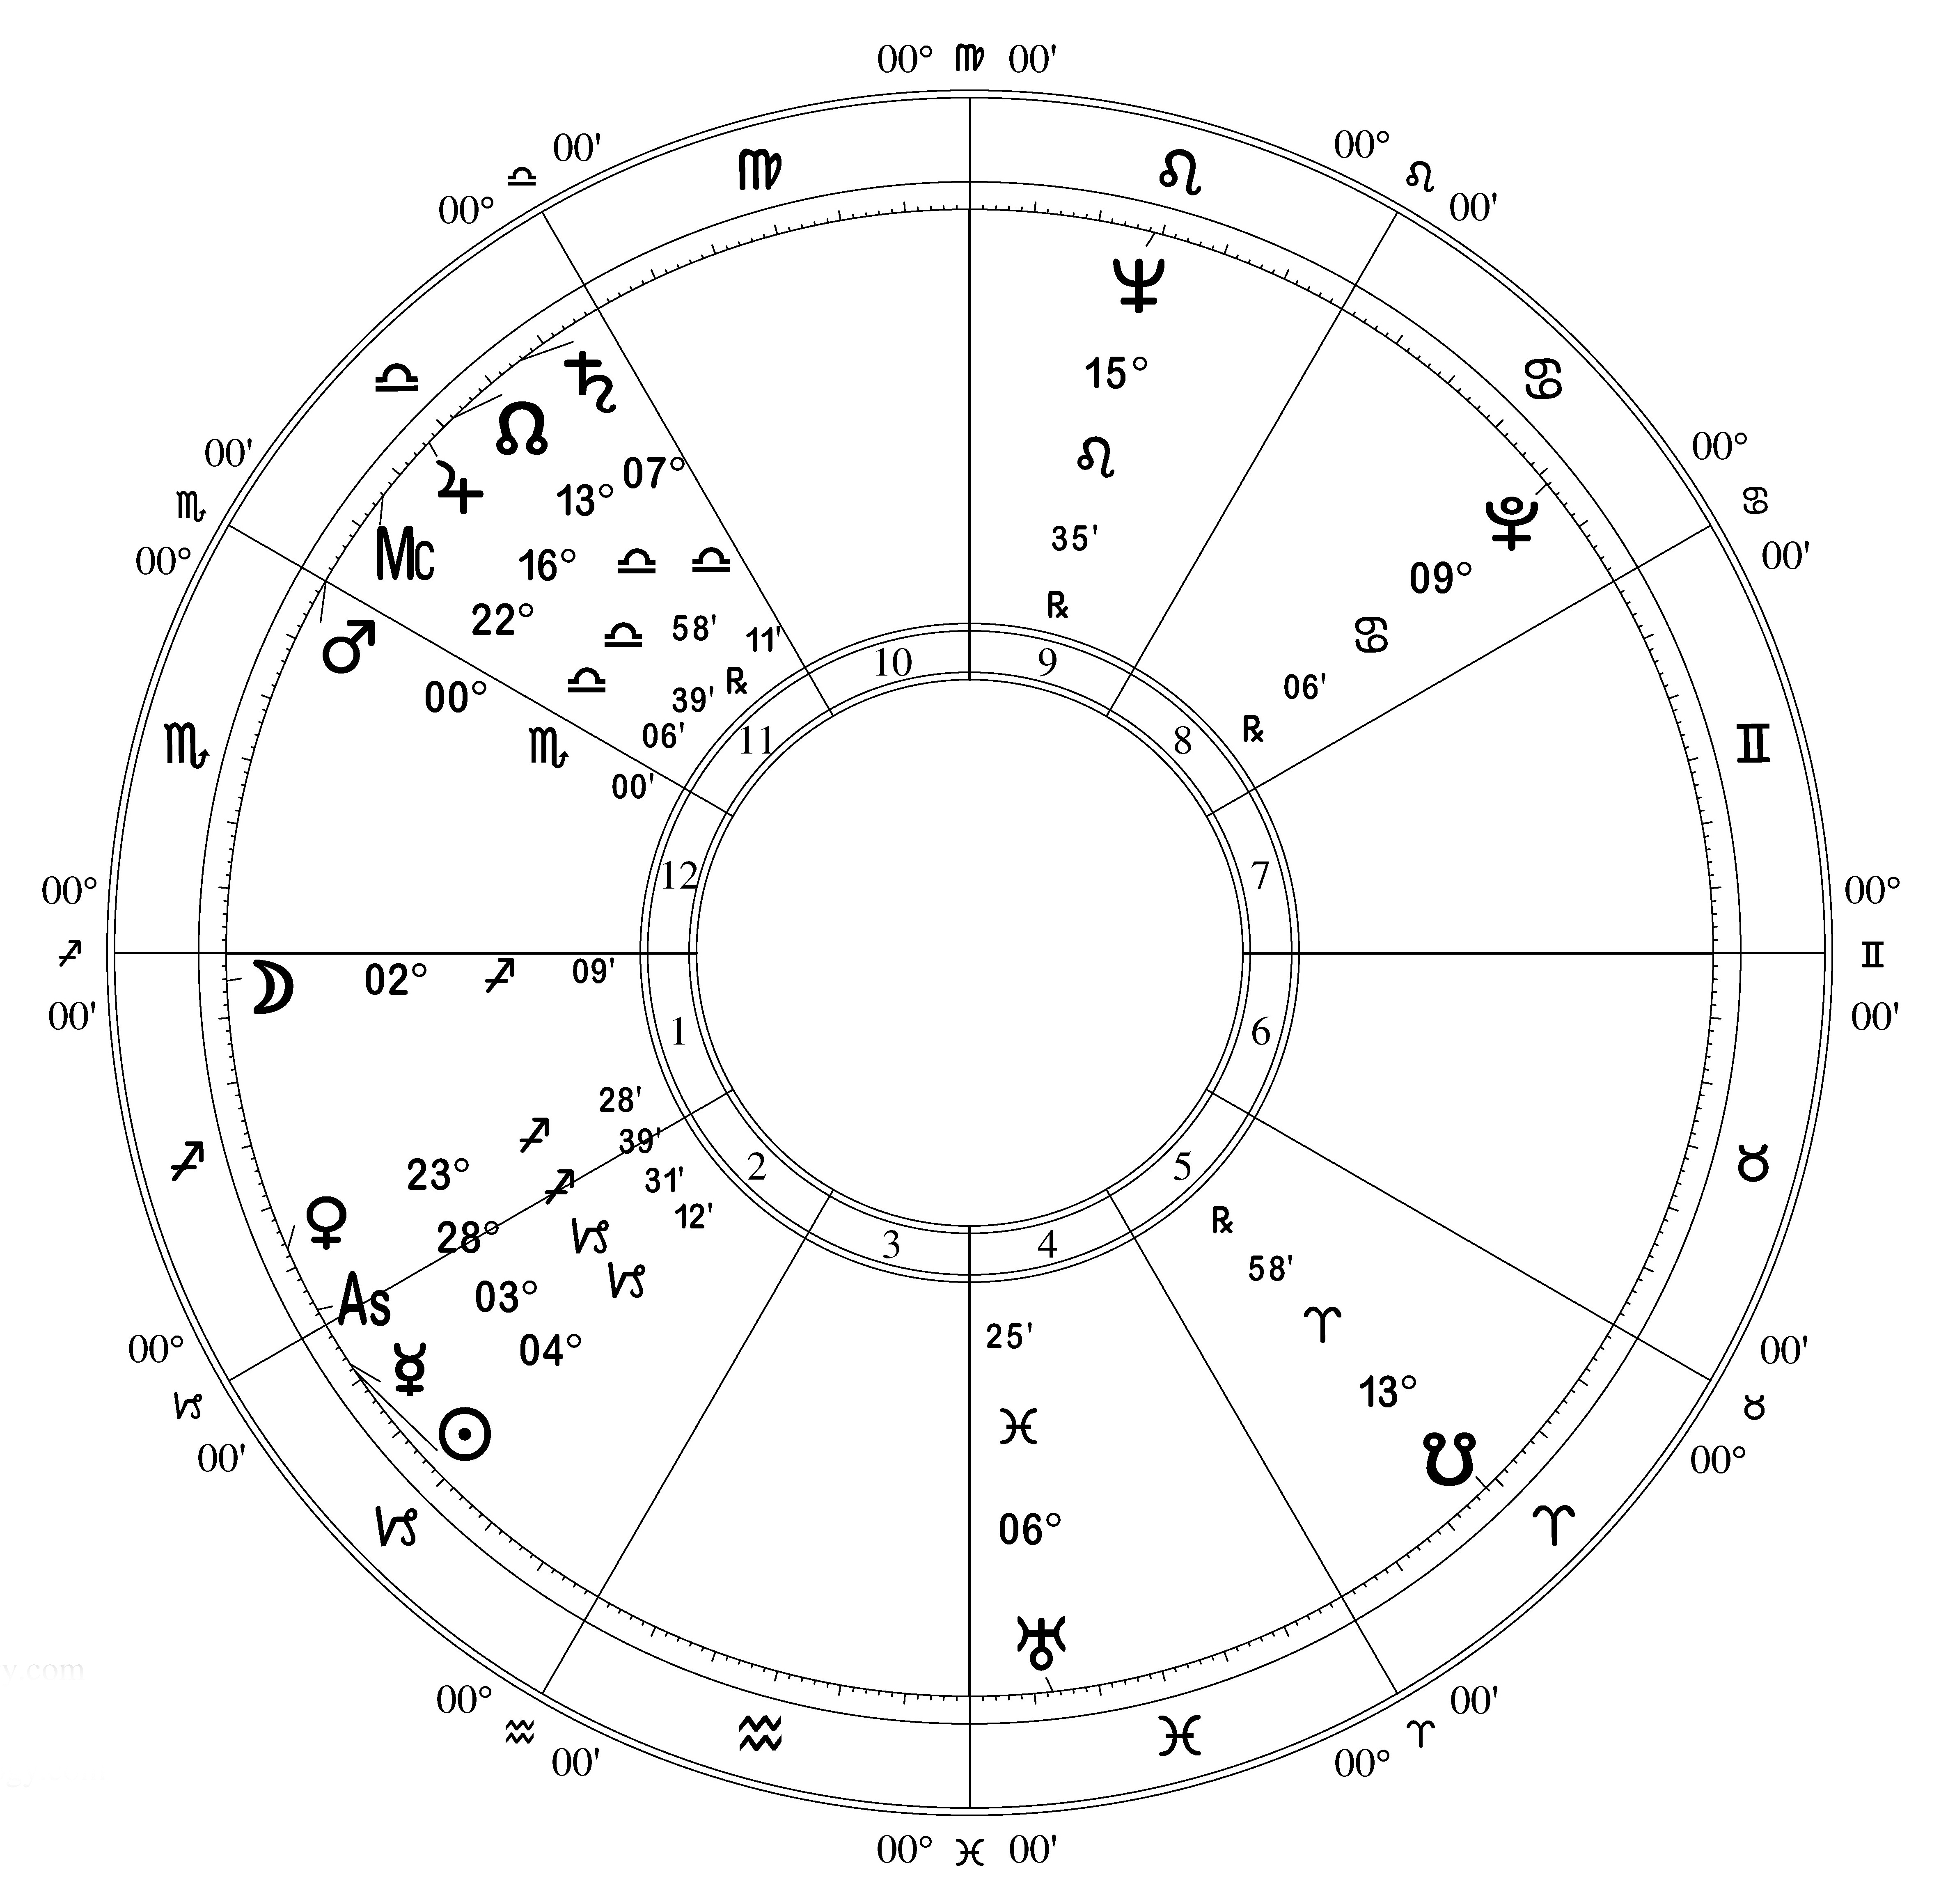
Steve Allen Entertainer, Musician, Comic

Slide 12
Steve Allen Entertainer, Musician, Comic
Example of mutual reception
Jupiter is conjunct the Midheaven.
Venus is conjunct the Ascendant.
Venus and Jupiter are in each other's signs in mutual reception, and rule both the main angles.
A charming, witty and gracious talk show host, and a fine jazz pianist.

Slide 13
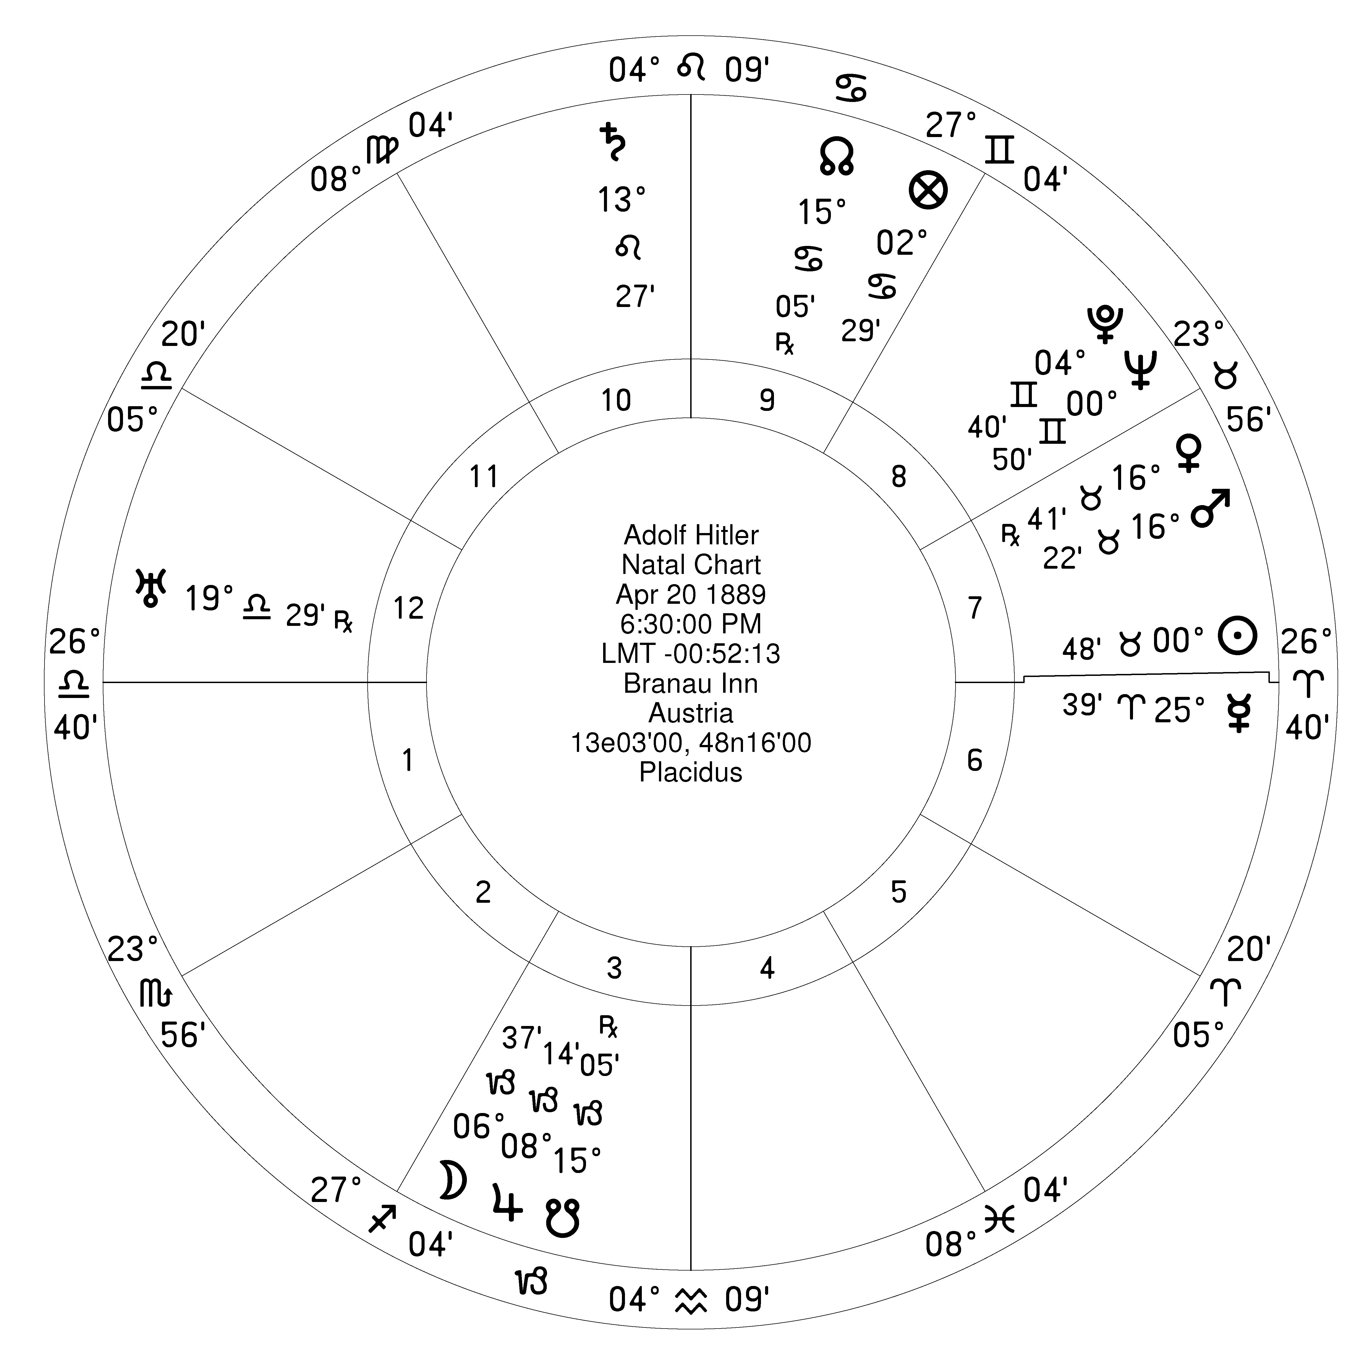
Adolf Hitler
Look at the dignities and reception between Saturn and Mars.

Slide 14
Adolf Hitler
Example of lack of reception
Saturn is in detriment and angular in the 10th.
Mars is in detriment, angular, and conjunct Asc ruler Venus.
Saturn and Mars are in a tight fixed square - and there is no reception between them at all!
Saturn and Mars are both in detriment and working at cross purposes - a constant fixed stress. Neither planet is getting much help with its bad condition.
Saturn in the 10th - rise to power followed by a fall.

Slide 15
Things to consider
When considering two planets in aspect, examine their reception to see how well they work together.
When examining the ruler(s) of a house, take into account if they aspect by whole sign or are averse. Check for aspects by antiscia also.
Planets that receive each other can have a mutual support even with aversion, although having an aspect is preferable.

Slide 16
Dispositor - Mohandas Gandhi

Slide 17
Dane Rudhyar

Slide 18
Almuten

Slide 19
Almuten
Almuten is from the arabic al-mubtazz, victor or winner.
The almuten is the planet that has the most influence at a given point, from adding up the total dignities.
In case of a conflict between planets, this decides which one dominates.
When looking for the almuten, take into account things like planetary condition, and aspects. This is as important as the combined point value.

Slide 20
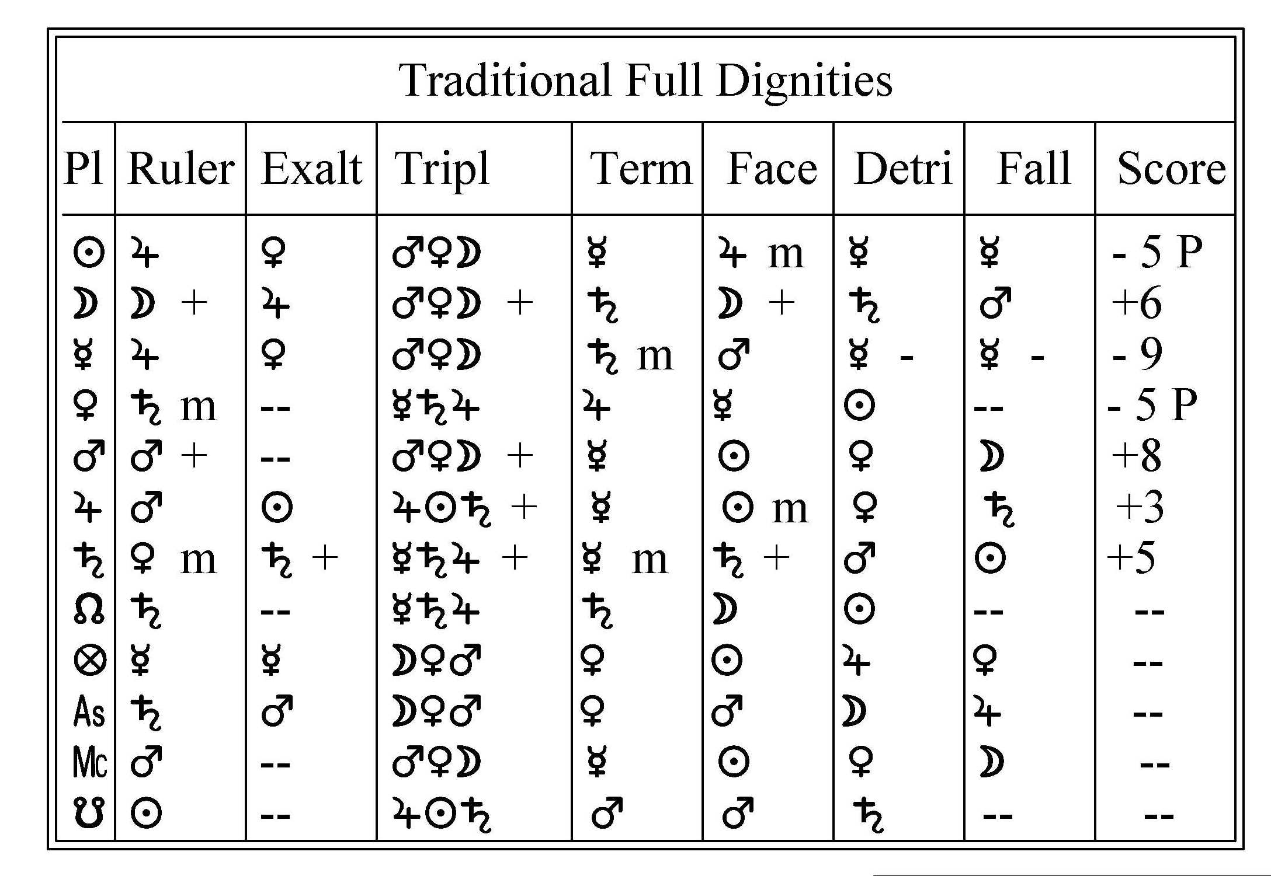
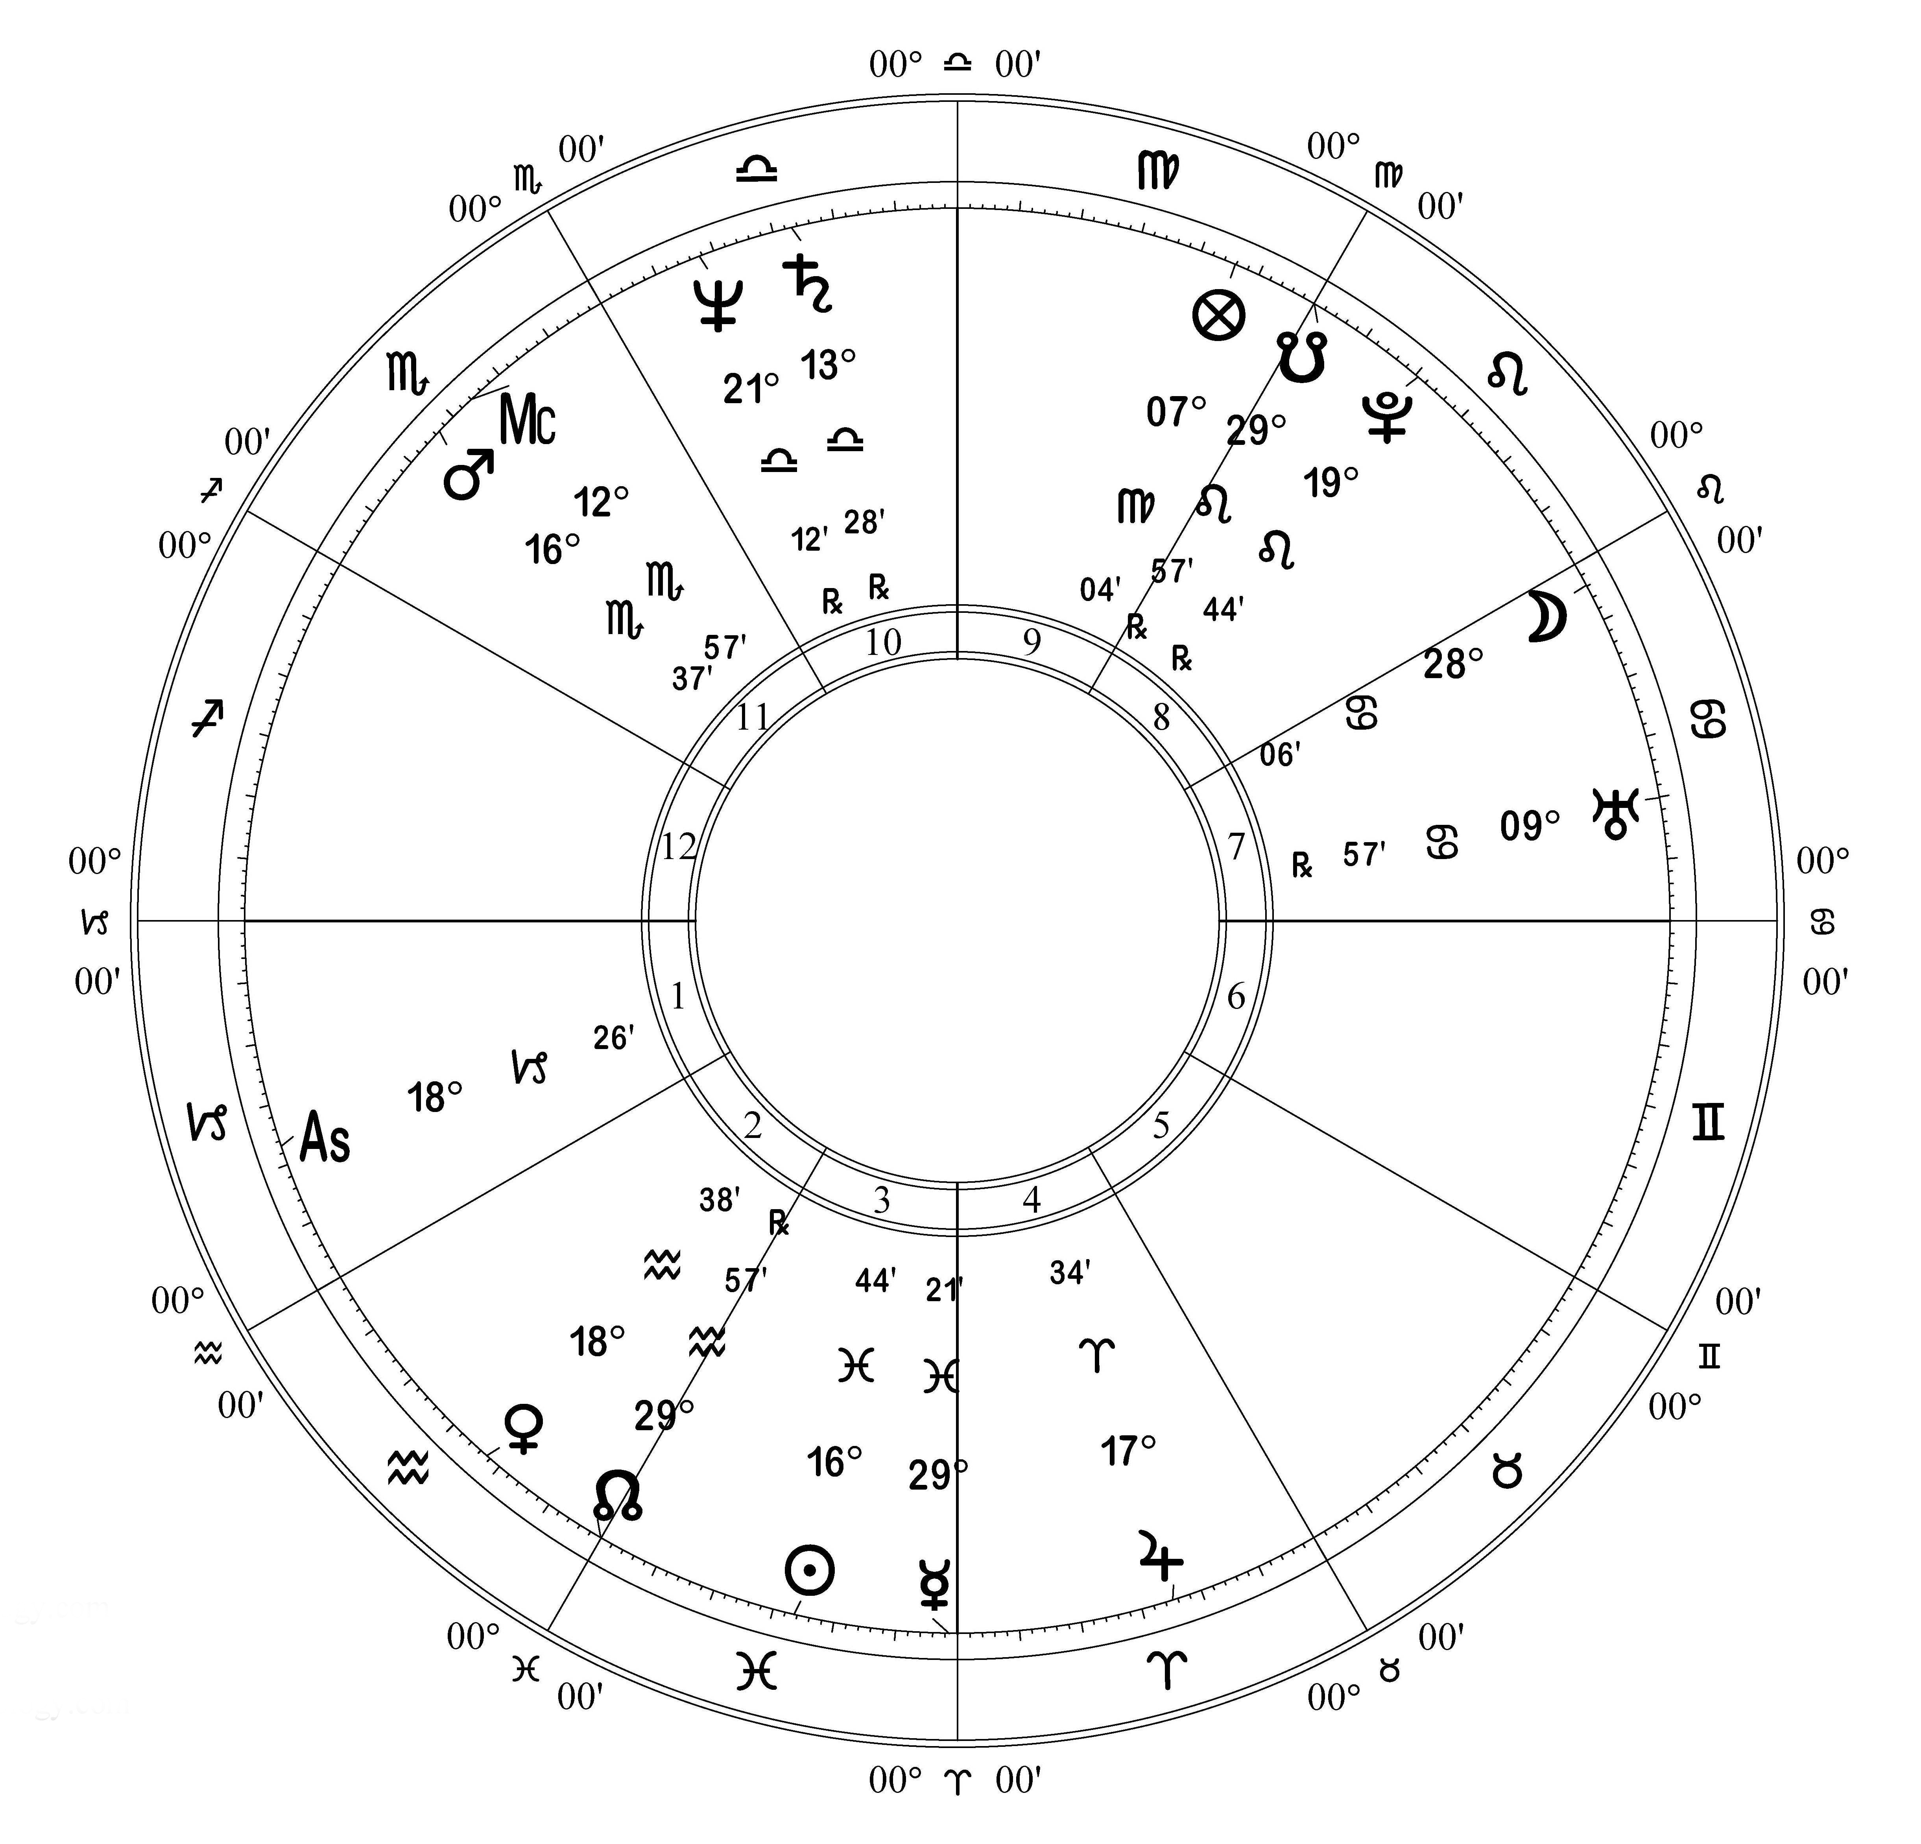
Almuten - example
Look at the dignities at the Ascendant.

Slide 21
Chart Almuten
Analyzing an entire chart, William Lilly uses the planet with the most overall dignity as the Almuten of the entire chart, and that planet is considered to have special importance and influence.

Slide 22
Peregrine

Slide 23
Peregrine
With the concept of dignity or assigned role, there needs to be a way of dealing with a planet that has no dignities at its location.
This is the concept of Peregrine. The word means wanderer or stranger. A peregrine planet is homeless, it has no assigned place and no rights.
A peregrine planet very much depends on the condition and aspects of the planets that rule its location to be able to function. It is a guest at the mercy of its hosts.

Slide 24
Bonatti
"Look to see whether a planet is peregrine, because then it signifies that he...will be clever, astute, malicious - for he will know how to do good and evil, and how to advance cleverly in all action which he wished; however, his intention will be more inclined toward evil than to good."
This is peregrine as "street smart", a homeless outsider used to living by their wits. Peregrine planets are not necessarily loyal to the same rules as the "insiders".
The survival skills of peregrine planets can be assets.

Slide 25
Peregrine in Horary vs. Natal
There is a difference in interpretation of peregrine planets in horary astrology compared to natal.
In horary a peregrine planet is considered to not be able to perform at all, so it cannot complete a given task.
Peregrine is used in horary in other specific ways - e.g. in a horary on theft, a peregrine planet in the 7th house is considered to show the thief.

Slide 26
Peregrine in Natal Astrology
In natal interpretation you need to take into account things like growth, experience, choice.
Over time, a peregrine planet can get used to functioning in its situation and can become a useful asset - an acclimation takes place.
With peregrine planets, it is very important to weigh up all of the planet's rulers - they rely on their rulers to function.
Look for the ruling planet in the best condition that aspects the peregrine planet in the most favorable way. You will likely see the planet's functioning is strongly influenced by its most powerful ruler.

Slide 27
Peregrine and the Dignity system
I think that the concept of peregrine only works if you use the full system of 5 major and minor dignities.
Using just the major dignities greatly increases the frequency of peregrine planets. I think this dilutes the significance of the condition.
So - if you use Peregrine, use the full five dignity system.

Slide 28
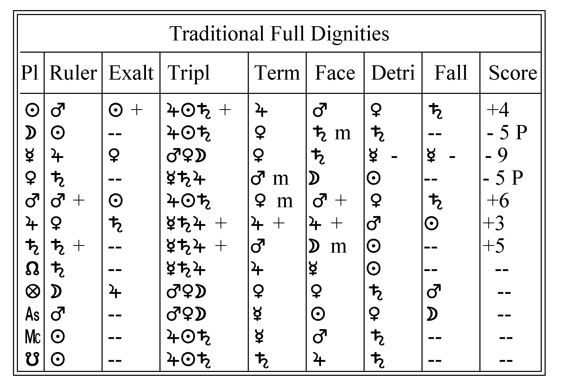
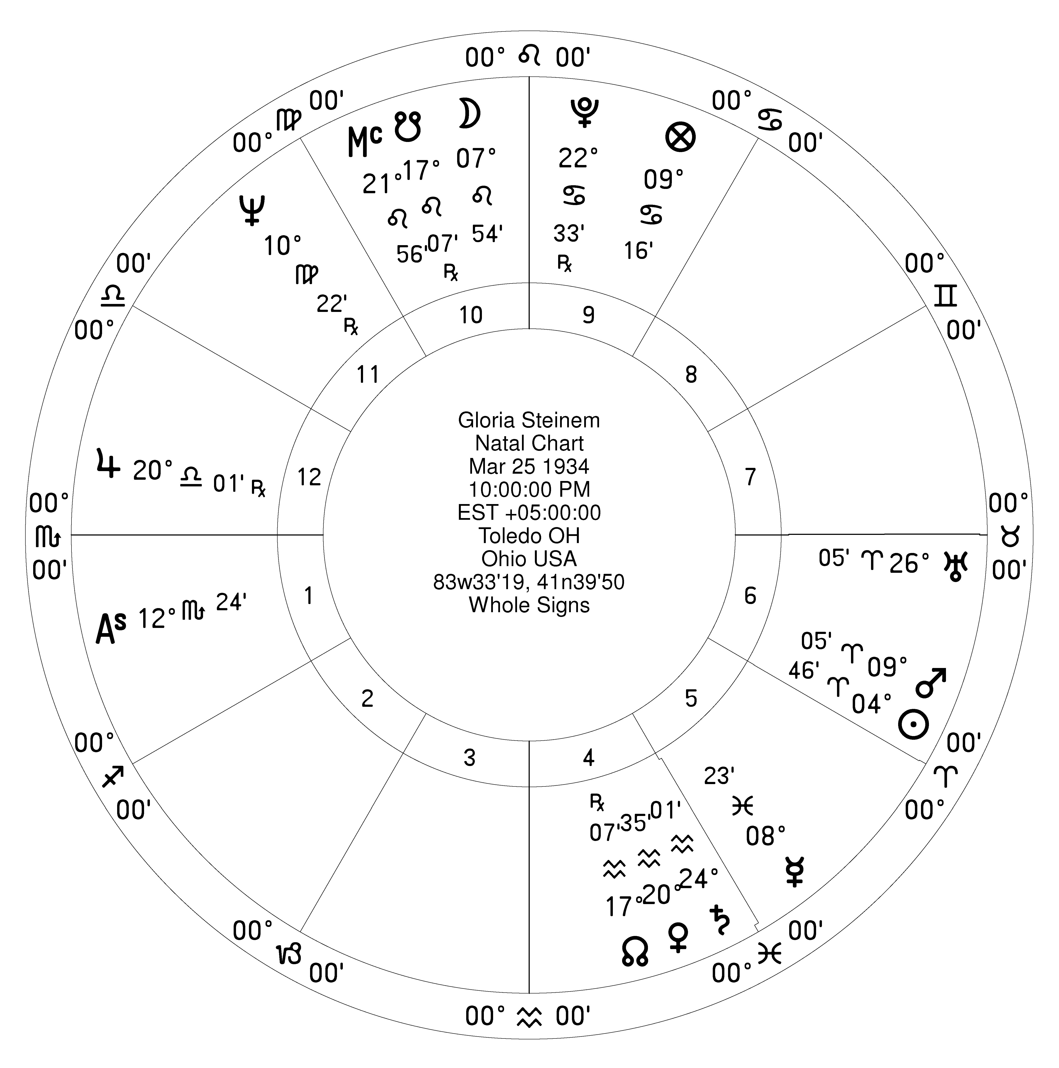
Gloria Steinem
The Moon in Gloria Steinem's cart is peregrine.
Which planets most strongly affect the Moon's functioning?

Slide 29
Accidental Dignity

Slide 30
Accidental Dignity
The essential dignities we are studying are all defined by zodiac location.
There is another category, called Accidental dignities, that are other conditions affecting the ability of planet to perform.
Essential and accidental dignities need to be weighed together to determine the condition of a planet.
We will consider the most used accidental dignities in the next pages.

Slide 31
Angularity
Angularity may be the single most important measurement of strength in the tradition.
The four angles of the chart, also called pivots or stakes, are the points of visibility and power.
A planet near or in an angular house is strong.
A planet in a succedent house is not as strong as angular.
A planet in a cadent house is thought to be weak, hidden, weakening, turning inward. The word cadent means falling away.

Slide 32
Good and Bad Houses
In weighing house strength and favorableness, there is a division into good and bad houses.
Houses 1, 10, 4, 5 and 11 are considered fortunate or good houses.
Houses 6, 8 and 12 are considered unfortunate or bad houses. All 3 are averse the ascendant.
Houses 2, 3, 7 and 9 are considered mixed, and can go either way.

Slide 33
Retrograde
In a system that greatly values order and regularity, any planet that is moving against the usual order is suspect, and is a problem.
That is what retrograde is - moving against the grain.
Retrogradation traditionally hinders, impedes, slows down, delays, blocks, and weakens.
Psychologically a retrograde period can also be a turning attention within.
Retrograde can also mean rebellious.

Slide 34
Combust, or Burnt
Being conjunct the Sun - either under the Sun's Beam's, or Combust if very close - is said to rob a planet of strength.
If a planet is anywhere near the Sun, you can't see it - it gets completely overwhelmed by the brightness and hotness of the Sun's fire.
A planet is combust if within 7 or 8 degrees of the Sun, and under the rays if within 15 degrees.
Both conditions are much worse if the conjunction is applying, and not as bad if separating.
A planet conjunct the Sun (15' to 1º) is Cazimi, and is greatly strengthened.

Slide 35
The North and South Node
The North Node traditionally was viewed as a benefic, similar to the planet Jupiter. The North Node magnifies or increases the effect of any planet near it.
Conversely, the South Node was viewed as malefic, of the nature of Saturn. The South Node traditionally diminishes, decreases or sucks the life out of any planet near it.
For the Moon it is considered unfortunate to be near either Node, since that is where the Moon could experience an eclipse.

Slide 36
Speed
Planets have an average motion in their daily movement.
A planet moving fast is considered to be strengthened.
A planet moving slowly is weakened, or doesn't act as quickly.
This is a minor consideration.
Moon 13d 10m 36s
Sun 0d 59m 08s
Mercury 0d 59m 08s (same as the Sun)
Venus 0d 59m 08s (same as the Sun)
Mars 0d 31m 27s
Jupiter 0d 4m 59s
Saturn 0d 2m 1s

Slide 37
Oriental and Occidental
A planet is oriental if it rises before the Sun, at an earlier zodiac degree. A planet at a later zodiac degree is called occidental.
The outer planets, Mars, Jupiter and Saturn, are all moving away from the Sun when they are oriental, and this strengthens them.
For the inner planets, Venus, Mercury and Moon, they are moving away from the Sun when occidental, and this strengthens them.

Slide 38
Oriental / Occidental
Venus rises before the Sun and is Oriental.
Mercury rises after the Sun and is Occidental.

Slide 39
Phase of the Moon
In traditional dignity systems, the Moon is considered stronger when it is waxing, increasing in strength.
The Moon when it is waning is decreasing in strength, and this is considered a debility.

Slide 40
Aspects with other planets
Planets are strengthened or weakened by their aspects with other planets.
A planet in hard aspect or conjunct a malefic is considered to be harmed, weakened.
A planet in smooth aspect or conjunct a benefic is considered to be benefited and strengthened.

Slide 41
Fixed Stars
Conjunctions with major fixed stars were considered to have an important effect, depending on the nature of the star.
Note that, following William Lilly, I allow up to 5º orb.

Slide 42
Essential vs Accidental Dignity
As a very general rule, Essential Dignity is a measure of the quality or condition of the planet.
As a general rule, Accidental Dignity is a measure of the prominence and activity of a planet, its opportunity to act in the world.
This is an oversimplification - in a later section we will look at how the actual situation is more complex.

Slide 43
Putting the System Together

Slide 44
Origins
As we have seen, originally the 5 dignities were not a single tightly knit system. They were probably each used separately.
The 5 essential dignities were combined and developed into a ranked system.
The combination of essential and accidental dignities were used to show the strength or weakness of a planet, and how helpful or harmful its action would be.

Slide 45
Descriptions of the Dignities
By the late Arabic and early European period, the descriptions of the different levels of dignity mostly relate to levels of power or responsibility.
The descriptions have gotten vaguer and less concrete in usage than was the case in the earlier Hellenistic practice.

Slide 46
The Dignities in Ibn Ezra (the order matches Al-Biruni)
When a planet is in its domicile, it is like a person in his home.
A planet in its exaltation is like a person at its greatest rank.
A planet in its bound is like a person in his residence or seat.
A planet in its triplicity is like a person with his relatives.
A planet in its face is like a person with fine ornaments and clothing.

Slide 47
From Bonatti
Look to see if a malefic planet were the significator of some matter or some beginning, and and he were in his domicile or exaltation or bound, or triplicity, and in the angles or succedents: because then he is said to be strong like a benefic.
Note that face is omitted; that any of the other 4 diginities suffices by itself; and that these essential dignities are grouped in with the accidental dignity of angularity by house placement.

Slide 48
Weighing and Combining
Originally there no clear sense of any of the dignities being stronger than the others.
Some of the early Greek and Arabic texts refer to "rulership or triplicity or exaltation or term" without distinguishing strength.
During the Persian and Arabic periods of traditional astrology, the different dignities were assigned different weights or levels of strength in a ranked system.

Slide 49
Relative Weighting
Dignity | Score
Rulership | 5
Exaltation | 4
Triplicity | 3
Term | 2
Face | 1
This is the most common method of weighting the relative strength of the different dignities.
It became the standard in English speaking astrology after the publication of William Lilly's Christian Astrology in 1647.

Slide 50
Relative Weighting – Alternate
Dignity | Score
Rulership | 5
Exaltation | 4
Term | 3
Triplicity | 2
Face | 1
This is an earlier form of scoring. Note that Term and Triplicity have switched places.
After playing with both, I have come to prefer this scoring. I think Term is stronger than Triplicity.

Slide 51
William Lilly's Cheate Sheete
We will use the Table of Fortitudes and Debilities to show how the different dignities and debilities can be used as a scoring system to determine the strength or weakness of a planet.
I call it a Cheate Sheete because I think its most important purpose is as a teaching tool, to learn how to scan for and weigh these different conditions.
You will see that there are problems with just totalling up a simple score and relying on that one number.

Slide 52
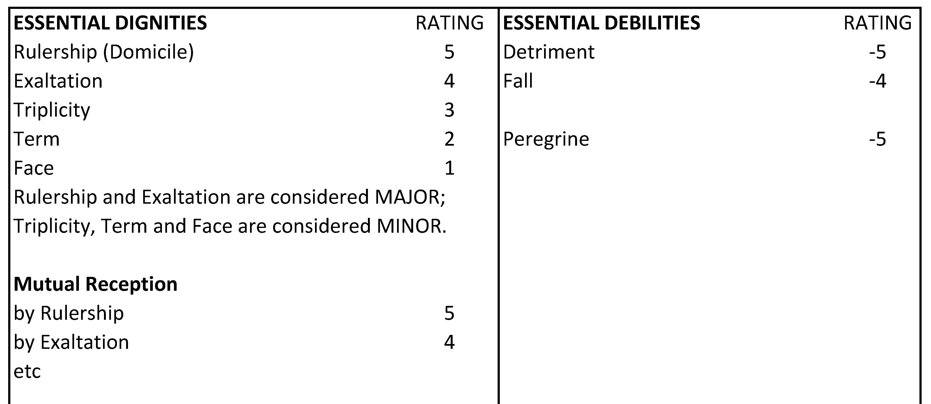
Lilly's Cheate Sheete - Essential

Slide 53
Cheate Sheet - Accidental

Slide 54
Cheate Sheet - Accidental

Slide 55
Cheate Sheet - Accidental

Slide 56
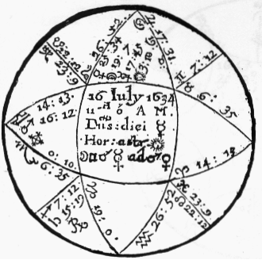
If He Be Rich or Poor
This chart is from Lilly, p. 177. It is the only chart in the horary volume where he walks through adding up the dignities and debilities from his table, to show how to use it.

Slide 57
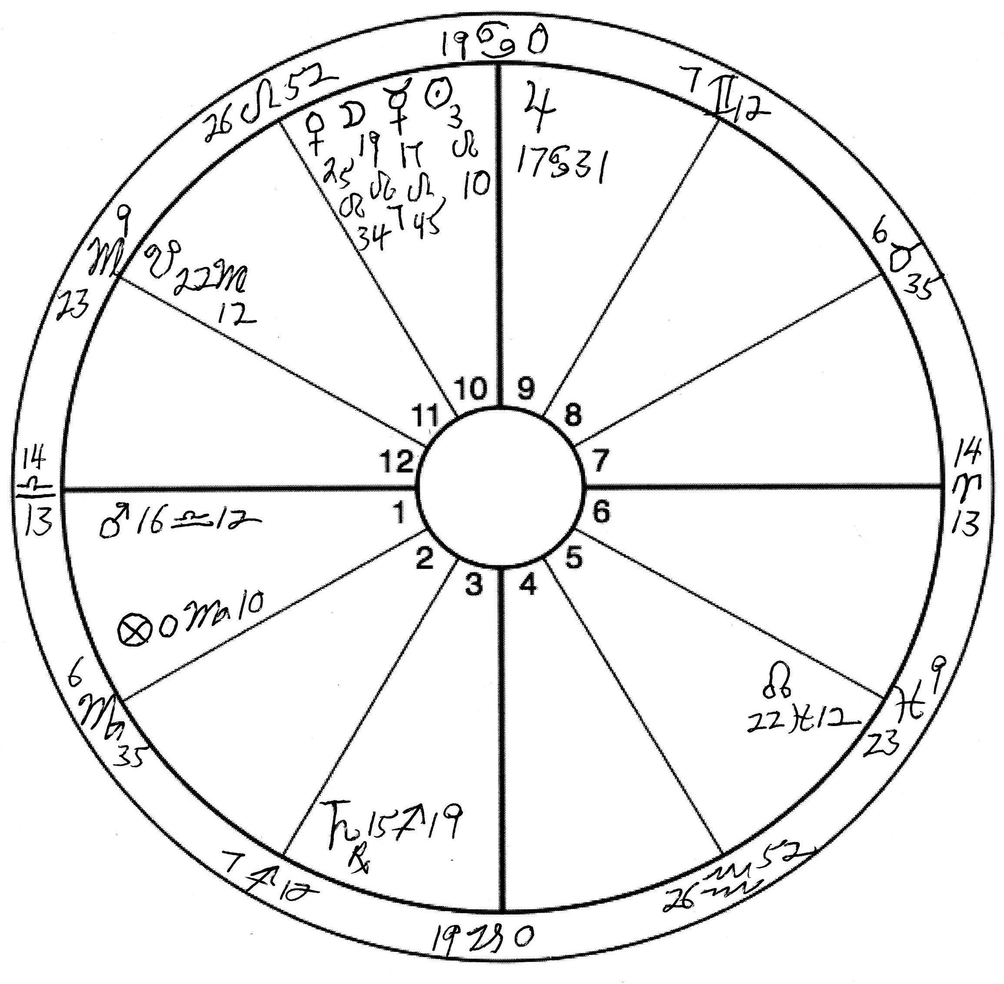
This is the same chart drawn in modern format.
Note that, for all examples from Lilly, I use his system of Triplicity and Term rulers to be consistent with his practice.

Slide 58
Example weighing up a planet
Mars His Dignities
No essential dignities
In the Asc +5
Direct motion +4
Not combust +5
Swift in motion +2
Conjunct fixed star Spica +5
Total +21
His Debilities
In detriment -5
Peregrine -5
Occidental of Sun -2
Total -12
Combined total +9

Slide 59
Example weighing up a planet
Jupiter His Fortitudes
In Exaltation, +4
In the 10th +5
Direct motion +4
Not combust +5
Swift motion +2
Total +20
He has no Debilities, either accidental or Essential, yet some Detriment it is to him, being in Square with Mars, though the aspect be platic (not in the same degree).

Slide 60
Example weighing up a planet
Saturn His Dignities
No essential dignities
In the 3rd House +1
Not combust +5
Total +6
His Debilities
Peregrine -5
Retrograde -5
Slow in motion -2
Occidental of Sun -2
Total -14
Combined total -8

Slide 61
Advantages and Disadvantages
Advantage of this scoring system - it gives a good way to get a sense of the relative strength or weakness of the planet.
Disadvantage - it blurs the meanings of the individual dignities and debilities in the overall score.
Suggestion - do use the scoring system, but keep in mind the meanings of the individual conditions, as some are very important.

Slide 63
Pope Francis

Slide 64
Francis Chosen Pope

Slide 65
Adolf Hitler

